Slide 1


WELCOME
AC CAPSTONE- Data Driven Project Management
Associated Client - CANADA REVENUE AGENCY(CRA)

Slide 2




Project Details
Hypothesis:
Project costing estimates and actuals remain consistent throughout the duration of the project.
Project objectives
Predict the Actual Cost of a WBS (Work Breakdown Structure) element across months.
Visualize monthly cost variance of WBS elements.

Slide 3
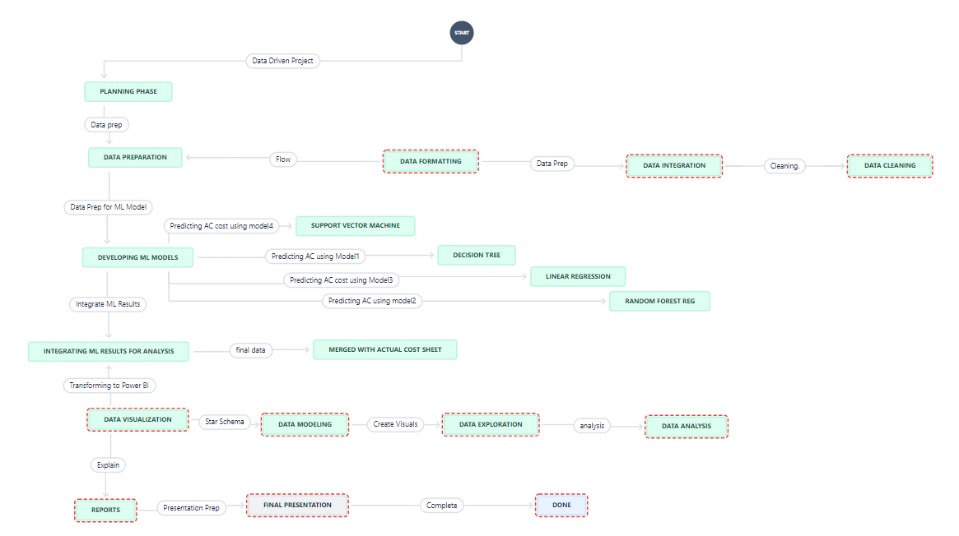
PROJECT WORKFLOW

Slide 4
Project Dataset Overview
P01 Regional Airport Carpark.
This project involved the construction of two new carparks and new vehicle access to the front of the terminal at a mid-size regional airport.
P02 Regional Landfill Cell.
This project included the construction of a 2 Ha lined landfill cell and leachate collection system in regional Queensland.
P03 – Regional Bypass Road.
This project included the widening and strengthening of approximately three kilometers of arterial road to allow bypass of a regional mining town for heavy vehicles.
P04 – Regional Development Road.
This project included the pavement rehabilitation and repairs at multiple sites along a 27 km section of a regional arterial road servicing the local mining industry.
P05 – Rehabilitation Two Roads.
This project included the rehabilitation of two roads following the 2011 Queensland floods. Works included the installation of large cross and longitudinal drainage, removal and replacement of saturated subgrades, strengthening with an unbound gravel overlay, bitumen seal and asphalt.
P06 – Urban Street Rehab.
This project included the reconstruction of multiple urban streets following the 2011 Queensland floods. Works included improvement of cross and longitudinal drainage, removal and replacement of saturated subgrades, replacement of all Kerbing, new gravels, bitumen, and asphalt seal.
P017 - Marina Subdivision
Detailed description of projects has not been provided
P018 – Rural Road Repairs
Detailed description of projects has not been provided
OPEN SOURCE DATA

Slide 5

Project Data Dictionary
Portfolio WBS WORKSHEET
Actual Cost WORKSHEET
Date
Description
Resource
Unit
Quantity
Rate
Total
Portfolio WBS
Portfolio WBS (Work Breakdown Structure)
Description
Quantity
UOM- Unit of Measurement
BAC
BAC Rate
Final Qty (AQ)
Final Cost (AC)
Final Rate
PQ- Planned Quantity
PV-Planned Value
AQ – Actual Quantity
AC - Actual Cost
EV- Earned Value

Slide 6
Feature Engineering
Re-Format data for month-based analysis
Merged 8 Project Dataset
Find difference from previous month to solve accumulating nature of data set
PQ, PV, AQ, AC, EV
New Columns :
Planned Quantity, Planned Value, Actual Quantity, Actual Cost, Earned Value
Date: The current month in project
Start: Month where calculated metrics are not zero
End: Month where there is no change in metrics, considered to be end of Portfolio WBS
Dropped rows where no work is done - 3632 - > 1953 (Rows)
3632
1953

Slide 7

Attributes Chosen For Machine Learning
Inputs:
Quantity
BAC
BAC Rate
Planned Quantity
Planned Value
Portfolio WBS
UOM
Month
Output:
Actual Cost

Slide 8
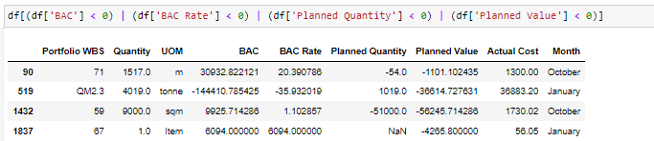
Data Cleaning : 1953 Rows
Convert columns to the appropriate data types.
Drop 275 rows where Planned Quantity, Planned Value, and Actual Cost are all zero.
Remove 614 rows where Actual Cost is zero.
Remove 627 rows where Planned Quantity and Planned Value are both zero.
Remove rows where BAC, BAC Rate, Planned Quantity, or Planned Value is negative.
Standardize duplicate unit of measure (UOM) names, such as "hrs.," "hr.," "week," "weeks," etc.

Slide 9
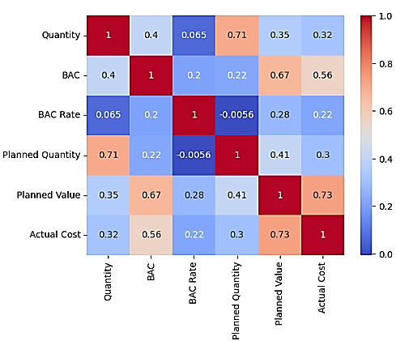
Correlations
Actual cost is the target variable, BAC and planned value are highly correlated

Slide 10
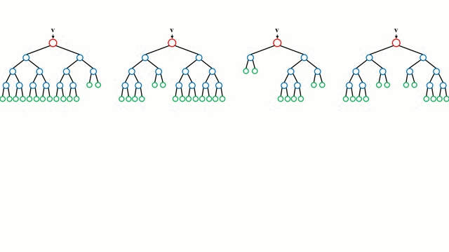
Machine Learning Models & Tools
Decision tree
Random Forest Regression
Linear Regression
Support Vector Machine
Python
Power BI
Power Point
Teams
Jira

Slide 11
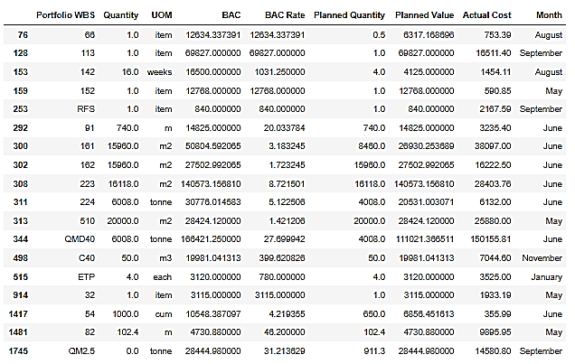
Portfolio WBS
The final dataset consists of 690 records.
During the train-test split, we required two classes of each WBS element. However, this situation occurred only once across eight projects for these WBS elements, so we removed these records.

Slide 12
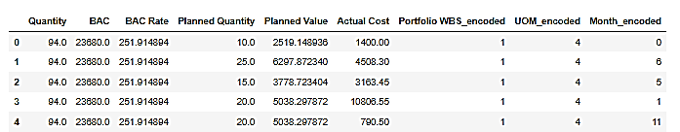
Label Encoding
Decision Tree & Random Forest Regression:

Slide 13

One-Hot Encoding
Linear Regression, Support Vector Machine
New Column for Each Portfolio WBS
Portfolio_WBS_11 Portfolio_WBS_23 Portfolio_24
1 0 0
0 0 1
0 1 0

Slide 14
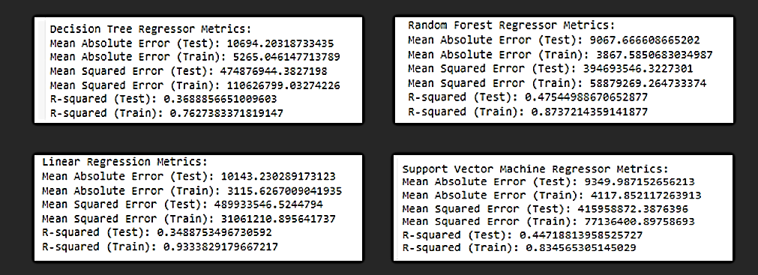
Machine Learning Results

Slide 15
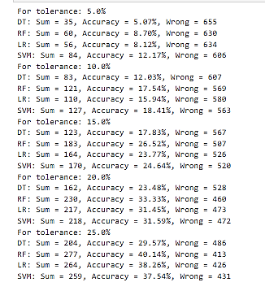
Accuracy of Models for Different Tolerance
Expectation is 15% margin of error
Best Performing model is Random Forest with 26.52%

Slide 16
Inconsistency in Months in EDM and Portfolio WBS Sheet
Portfolio Sheet
WBS Element 11 has work from April to November
EDM P01-EMB Sheet
WBS Element 11 has work planned in May and November for 1, 8 days respectively

Slide 17
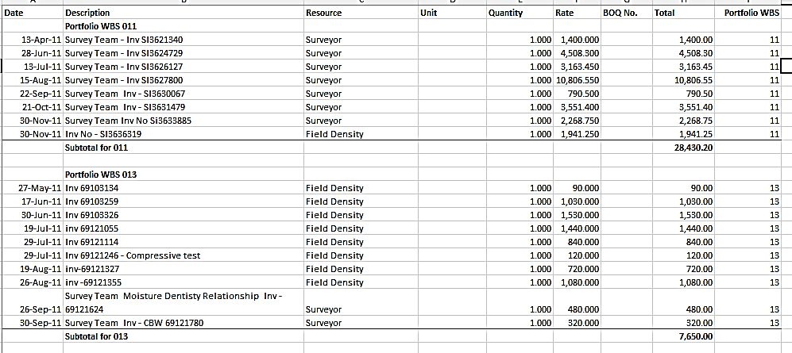
Actual Cost Sheet Merged for Visualization

Slide 18
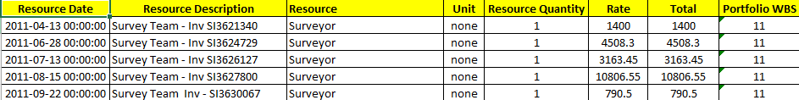
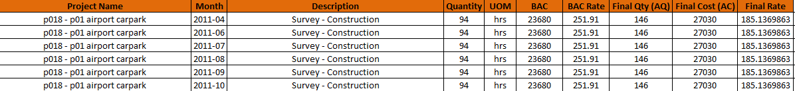
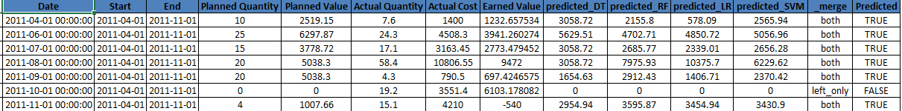
Preview of Final Dataset
Actual Cost Sheet Merged with Machine Learning Results on the following columns
Portfolio WBS
Year-Month
Project Name

Slide 19
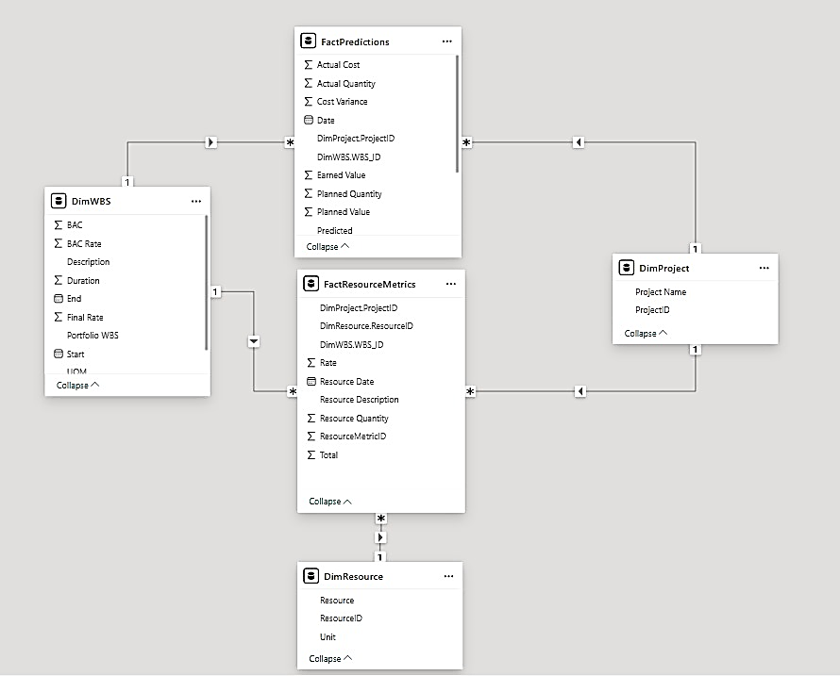

Star Schema with 2 Fact Tables

Slide 20
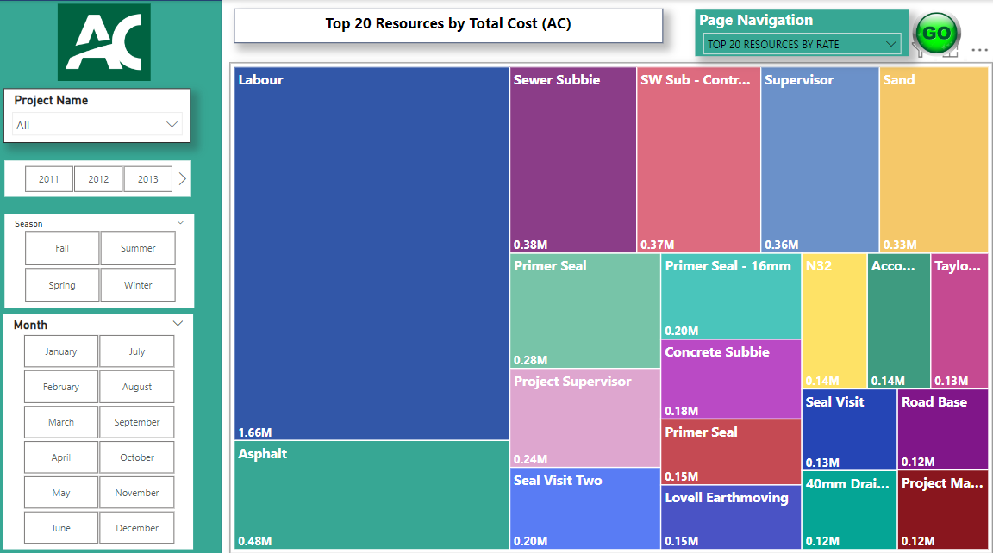

Slide 21
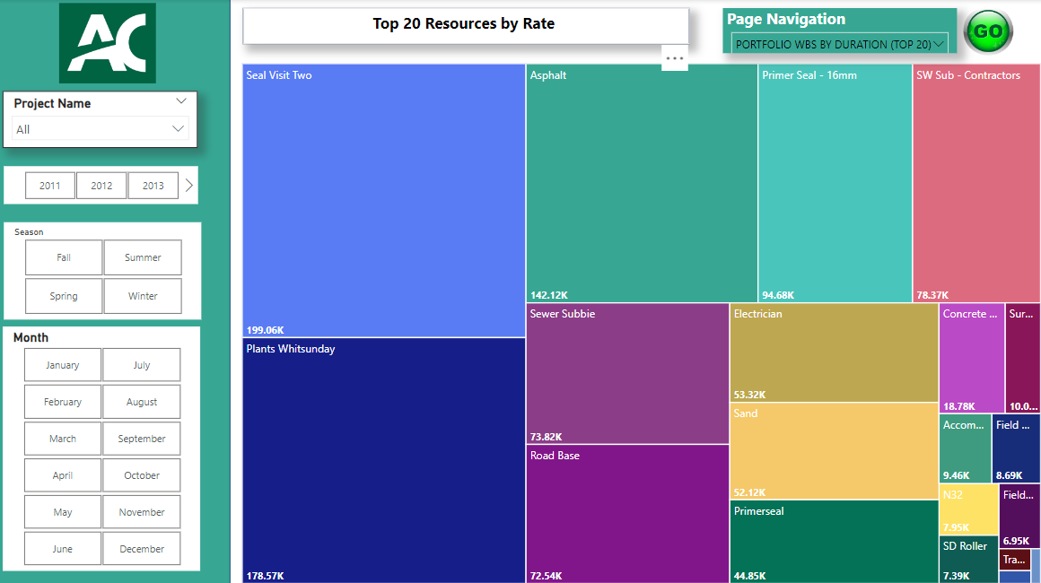

Slide 22
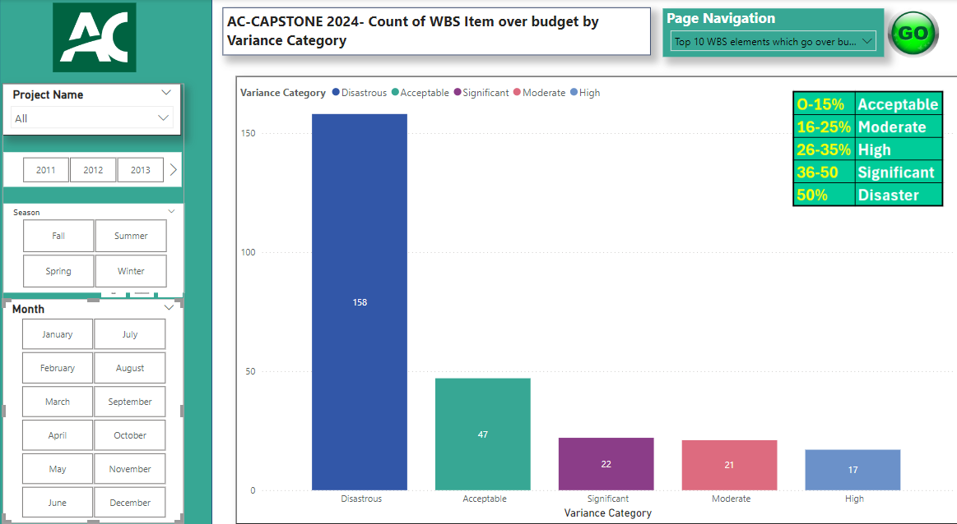

Slide 23
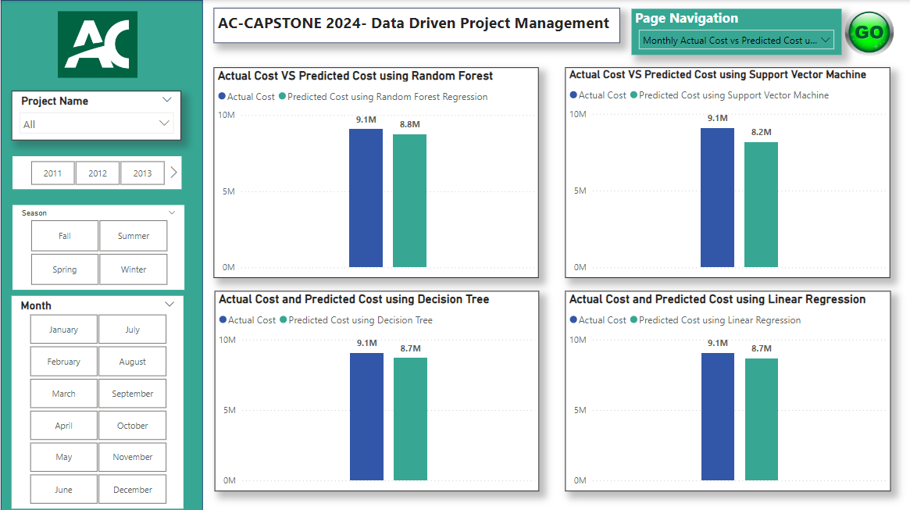

Slide 24
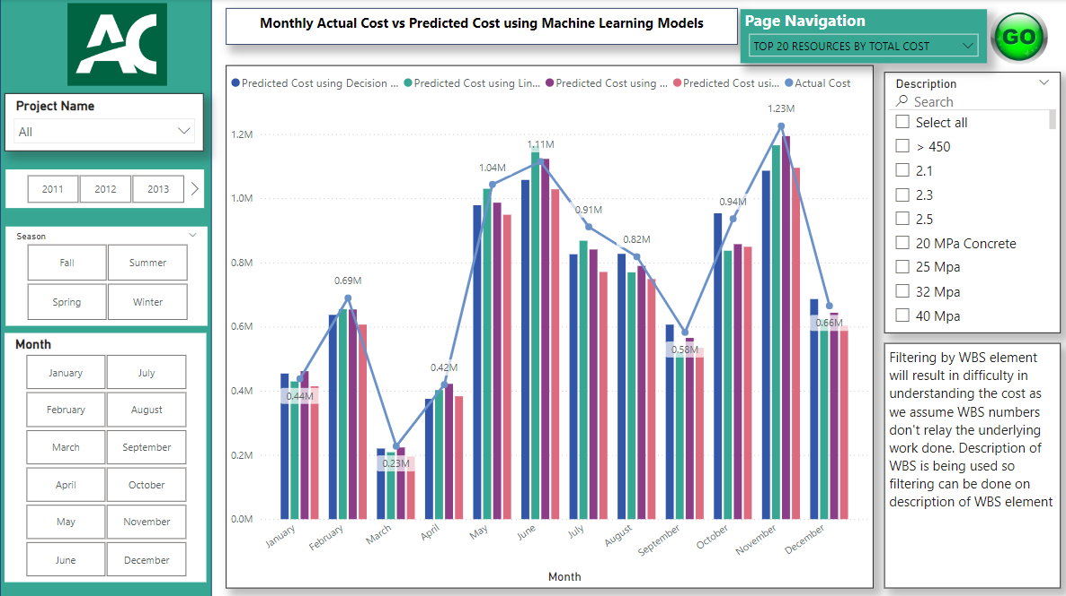

Slide 25
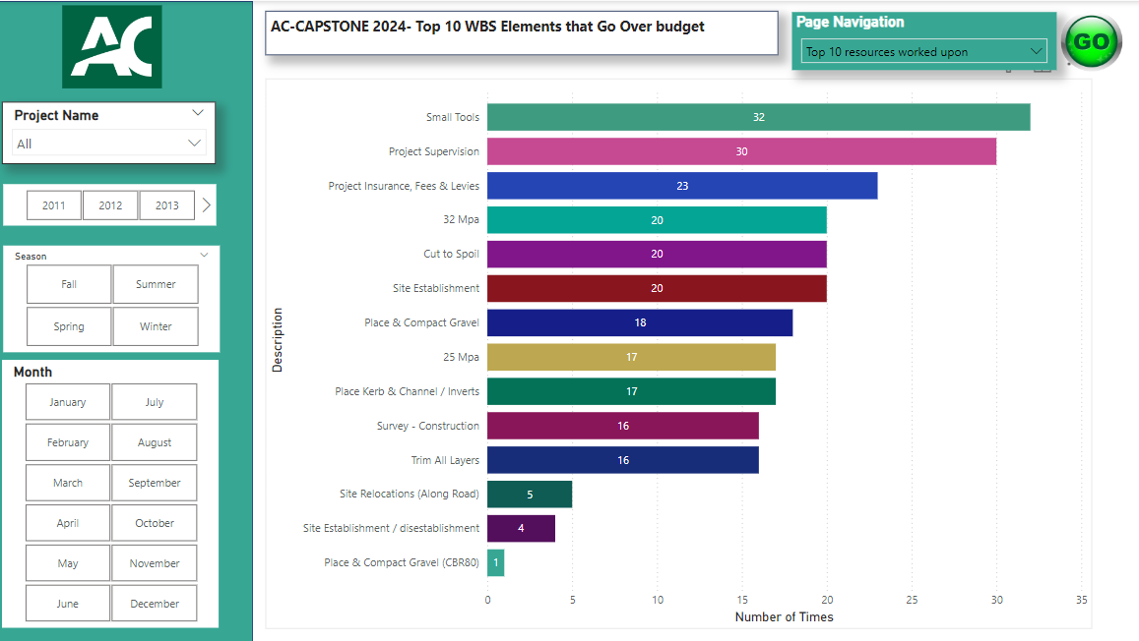

Slide 26
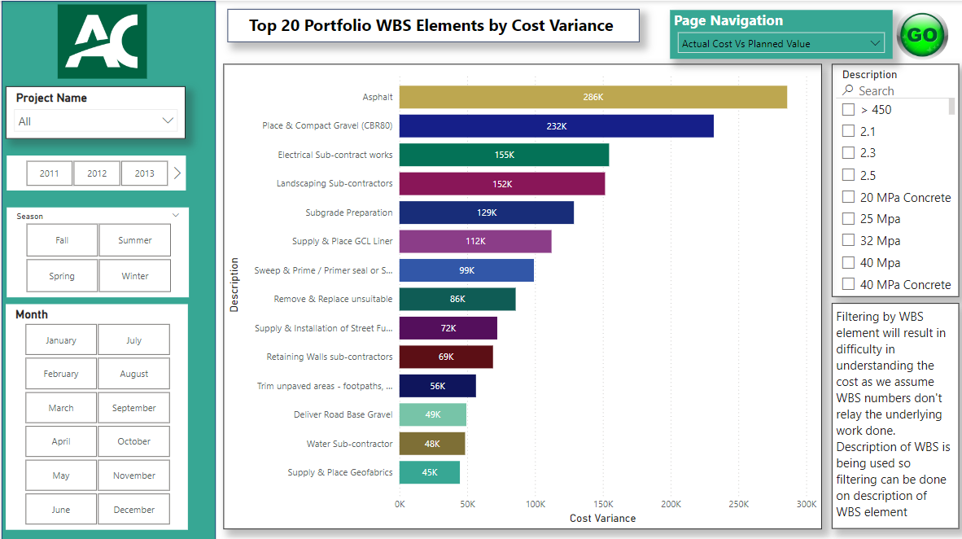

Slide 27

Main metrics for Analysis
Planned Quantity
Actual Quantity
Panned Value
Actual Cost

Slide 28
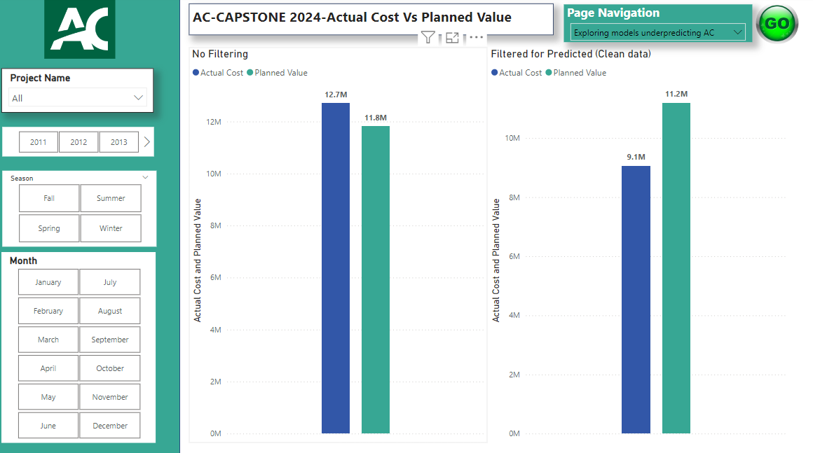

Slide 29
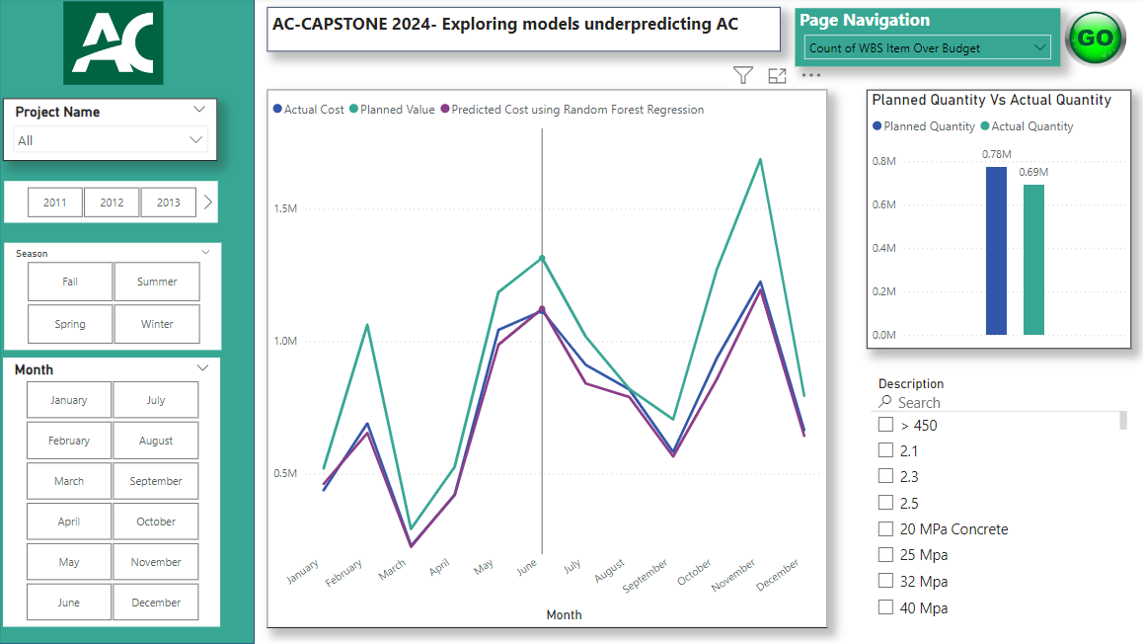

Slide 30
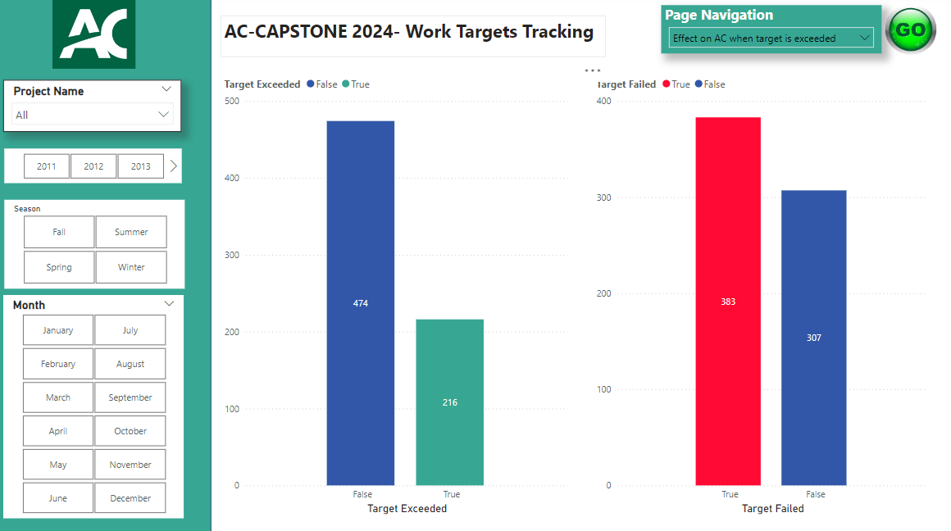
Target Exceeded = AQ > PQ
Target Failed = AQ < PQ

Slide 31
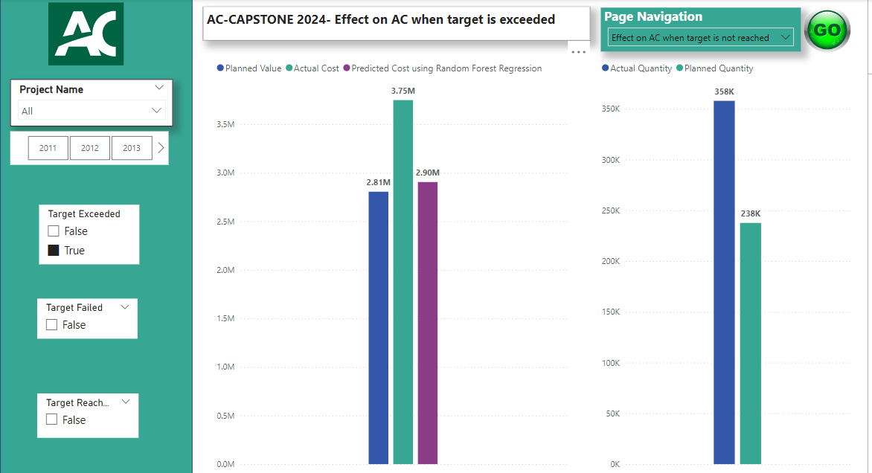

Slide 32
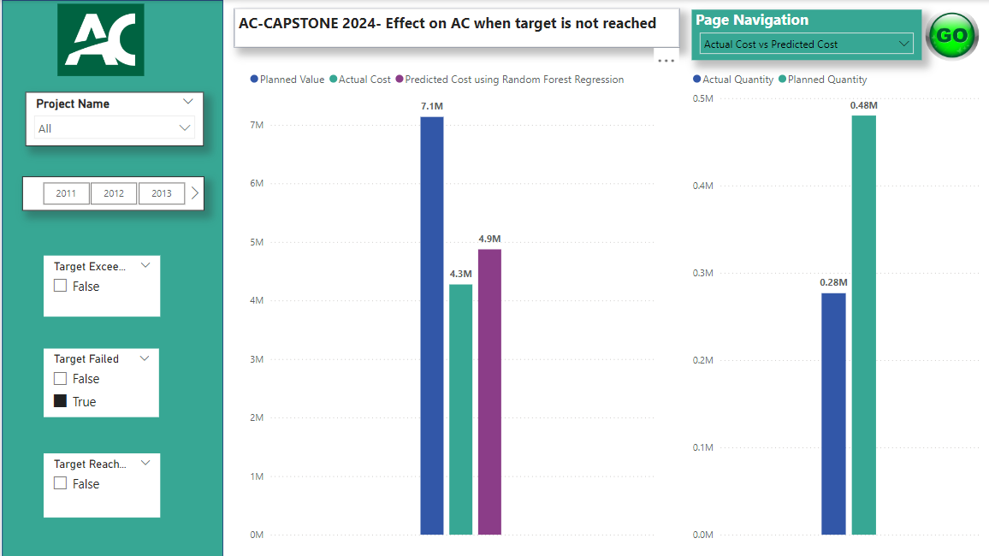

Slide 33
Conclusion
The model is trying to make accurate predictions for the case when work targets are not reached.
Recommendation
An additional metric can be included which shows the company or team working on the project and Duration of WBS Elements.
User can explore in power BI by filtering the data in the visuals to find the model making the closest prediction.

Slide 34


Slide 35
That’s all. Thank you! ☺
Any Questions?

